Slide 1


Microsoft Cognitive Services
democratizing intelligence
Language Understanding Intelligence Service (LUIS)
Notes:
So, what are Cognitive Services? Cognitive Services are a collection of artificial intelligence APIs, and we believe in democratizing artificial intelligence. So what that means is, regardless of your skill level -- whether you're a high school student running your first program or working in industry or in a giant enterprise -- that you should be able to use our APIs incredibly quickly in a matter of minutes.
And regardless of your platform -- whether you're on Android or IOS or Windows, or making a website -- all of our APIs are rest APIs, which means you can call them as long as you have an Internet connection. And so that's pretty huge because what we're doing is making it so that everyone can build these smarter, more context-aware applications.
The technology used in our APIs is the same technology that powers our products today. And so, when you think of things like the Bing search APIs, it's the same technology from Bing.
Today I’m going to talk with you about the entire collection spanning vision, speech, language, knowledge, and search.
The other things that I want to point out is that you can get started for free with all of the APIs, but we do have pricing available for a number of them, which are in public preview on Azure.
The other piece is the developer resources. So, all of our documentation is on the website and actually in GitHub as well, so we do welcome community submissions. We have a set of SBKs that are also available on GitHub where we welcome poll requests and post everything on there. The SBKs vary from API to API, but they are all included in this one repository for people to see.
And then we have three different communities that we support. We have our MSDN forums, our Stack Overflow, and we have User Voice that we use for feedback requests.

Slide 2








Why Microsoft Cognitive Services?
Easy
Flexible
Tested
Roll your own with REST APIs
Integrate into the language and platform of your choice
Built by experts in their field from Microsoft Research, Bing, and Azure Machine Learning
Simple to add: just a few lines of code required
Breadth of offerings helps you find the right API for your app
Quality documentation, sample code, and community support
GET A KEY
BUILD
Notes:
Why choose these APIs? They work, and it’s easy.
Easy: The APIs are easy to implement because of the simple REST calls. Being REST APIs, there’s a common way to implement and you can get started with all of them for free simply by going to one place, one website, www.microsoft.com/cognitive. (You don’t have to hunt around to different places.)
Flexible: We’ve got a breadth of intelligence and knowledge APIs so developers will be able to find what intelligence feature they need; and importantly, they all work on whatever language, framework, or platform developers choose. So, devs can integrated into their apps—iOS, Android, Windows—using their own tools they know and love (such as python or node.js, etc.).
Tested: Tap into an ever-growing collection of powerful AI algorithms developed by experts. Developers can trust the quality and expertise build into each API by experts in their field from Microsoft’s Research organization, Bing, and Azure machine learning and these capabilities are used across many Microsoft first party products such as Cortana, Bing and Skype.

Slide 3

Vision
From faces to feelings, allow your apps to understand images and video
Microsoft Cognitive Services
Give your apps a human side
Speech
Hear and speak to your users by filtering noise, identifying speakers, and understanding intent
Language
Process text and learn how to recognize what users want
Knowledge
Tap into rich knowledge amassed from the web, academia, or your own data
Search
Access billions of web pages, images, videos, and news with the power of Bing APIs
Notes:
What are Cognitive Services? Microsoft Cognitive Services are a new collection of intelligence and knowledge APIs that enable developers to ultimately build smarter apps.
NOTES: key concepts we are trying to convey in this above statement:
That we are bringing together Intelligence (Oxford) and Knowledge from the corpus of the web (Bing)
That cognitive = human perception and understanding, enabling your apps to see the world around them, to hear and talk back with the users—to have a human side.
What are Microsoft Cognitive Services?
Microsoft Cognitive Services is a new collection of intelligent APIs that allow systems to see, hear, speak, understand and interpret our needs using natural methods of communication. Developers can use these APIs to make their applications more intelligent, engaging and discoverable. To try Cognitive Services for free, visit www.microsoft.com/cognitive.
With Cognitive Services, developers can easily add intelligent features – such as emotion and sentiment detection, vision and speech recognition, knowledge, search and language understanding – into their applications. The collection will continuously improve, adding new APIs and updating existing ones.
Cognitive Services includes:
Vision: From faces to feelings, allow apps to understand images and video
Speech: Hear and speak to users by filtering noise, identifying speakers, and understanding intent
Language: Process text and learn how to recognize what users want
Knowledge: Tap into rich knowledge amassed from the web, academia, or your own data
Search: Access billions of web pages, images, videos, and news with the power of Bing APIs

Slide 4
Cognitive Services API Collection
Vision
Computer Vision | Emotion | Face | Video
Microsoft Cognitive Services
Give your apps a human side
Speech
Bing Speech | Custom Recognition | Speaker Recognition
Language
Bing Spell Check | Language Understanding | Linguistic Analysis | Text Analytics | Translator | Web Language Model
Knowledge
Academic Knowledge | Entity Linking | Knowledge Exploration | Recommendations
Search
Bing Autosuggest | Bing Image Search | Bing News Search | Bing Video Search | Bing Web Search
Notes:
At Microsoft, we’ve been offering APIs for a very long time across the company. In delivering Microsoft Cognitive Services API, we started with 4 last year at /build (2015); added 7 more last December, and today (May 2016) we have 22 APIs in our collection.
Cognitive Services are available individually or as a part of the Cortana Intelligence Suite, formerly known as Cortana Analytics, which provides a comprehensive collection of services powered by cutting-edge research into machine learning, perception, analytics and social bots.
These APIs are powered by Microsoft Azure.
Developers and businesses can use this suite of services and tools to create apps that learn about our world and interact with people and customers in personalized, intelligent ways.

Slide 5
The problem
Language understanding in human-computer interaction is:
Technically challenging
Costly
to implement
Often
domain specific
It’s exceedingly difficult to enable a computer to understand what a person wants and to find the pieces of information that are relevant to their intent.
Building and maintaining machine learning systems requires a large investment of time, money and engineering resources
In the past, building your own machine learned models often required assistance of a team of data scientists that would customize the models to the specific domain.

Slide 6
A Microsoft Cognitive Service that provides developers with an easy way to create language models to allow applications to understand user commands.
Introducing Language Understanding Intelligence Service (LUIS)
Train by providing examples
Deploy to an HTTP endpoint and activate on any device
Create your own LU model
Maintain model with ease

Slide 7
LUIS Common Usage Scenarios
IoT experiences
Chat bots
Virtual assistance
LUIS has been used to build a wide range of IoT applications ranging from a simple voice activated lights control to smart kitchen appliances, smart vending machines, facial recognition door, and many more
LUIS offers integration with Microsoft Bot Framework and Slack, which enables developers to build and connect intelligent bots to interact with users no matter which device they are on or which technology they are using
LUIS uses pre-built models from Bing and Cortana which enable developers to easily add personal assistant functionalities to their apps.
Notes:
LUIS has events (entities) and actions (intents)
Example: TravelBot
3 Intents:
Book a flight
Dept city to arrival city (entity)
Departure date and return date (entities)
Utterance – different ways to say the same thing, NLP “I need to fly to paris”
Cancel a flight
Check me into a flight

Slide 8

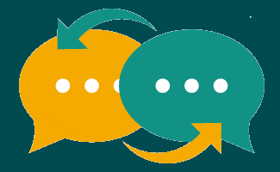


LUIS Benefits
Easy:
Use simple UX editor to create language understanding models
Fast:
Add conversational intelligence to your apps in minutes
Flexible:
Activate models on any device
Expert:
Leverages MSR technology
Create models for your application to better understand intents like "turn on the lights", or entities such as "start a new jog/walk/hike/bikeride". Tune your model with in-depth performance visualizations.
LUIS has a powerful dialog engine that enables you to maintain context, author and execute any dialog in just a few steps.
Activate your language understanding models from your application on your phone, tablet, or any other device that has access to the Internet.
LUIS leverages innovative AI technology from Microsoft Research.

Slide 9

Why LUIS?
It is fast and easy
It learns and adapts
It is innovative
It uses pre-built applications
LUIS is designed to enable you to quickly deploy an HTTP endpoint that will take the sentences you send it and interpret them in terms of the intention they convey and the key entities that are present.
After your endpoint has processed a few dozen interactions, LUIS begins active learning. LUIS examines all the utterances that have been sent to it, and calls to your attention the ones that it would like you to label.
LUIS relies on the cutting-edge technologies developed and incubated directly by Microsoft Research that have been tried and tested with hundreds of internal and external customers all over the globe.
In addition to allowing you to build your own applications, LUIS also provides selected models from the Microsoft Cortana personal assistant as a pre-built application.

Slide 10
Key features
Easy creation of LU models
Active learning
Action fulfillment
Dialog support
LUIS offers a set of user-friendly tools that completely abstract technical complexity and get you up and running with just a few steps.
This breakthrough feature enables LUIS to examine all the utterances that have been sent to it, critique its own work, and ask for any corrections in order to continually improve accuracy.
LUIS is able to fulfill actions that were triggered through a set of channels (HTTP, news, stocks, etc.)
LUIS provides a way to add a prompt question if user query is missing any of the required parameters

Slide 11

How LUIS works

Slide 12
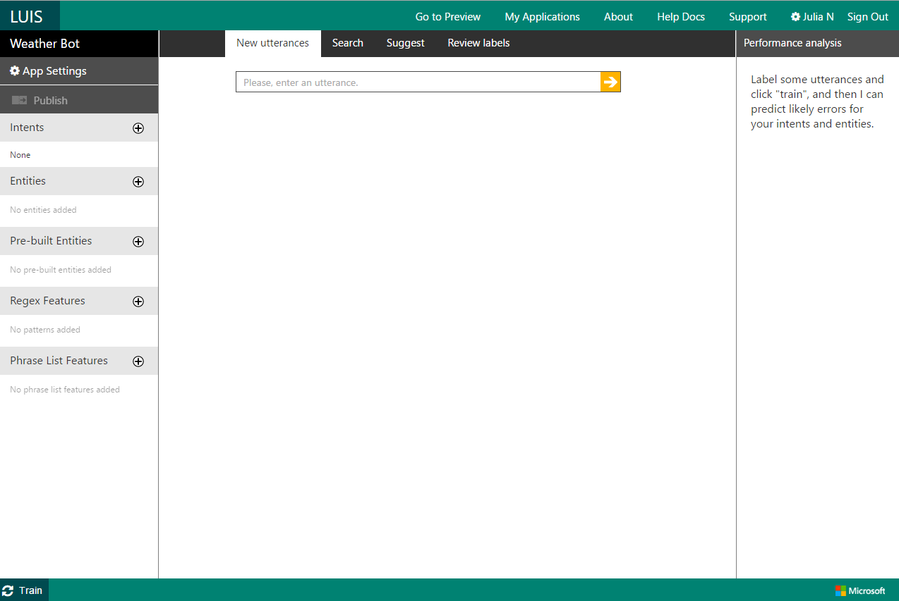
How LUIS works
Create a New App
1
Go to luis.ai:
Sign in with your Microsoft account (MSA). If you don’t have MSA, you will have an option to create one.
Get started by creating a New App and entering some basic information.
Next, you will be presented with the Application Editor Workspace that will allow you to create and train your own language understanding model.

Slide 13
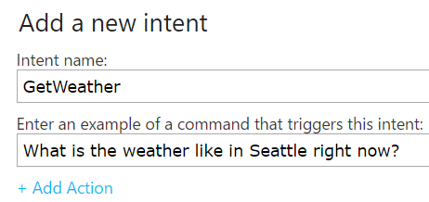
How LUIS works
Add intents and
entities
2
Intents:
Intents are actions that a user wants your app to take or the information they would like to obtain.
Example intents could include getting weather, booking tickets, adding a calendar entry or operating a light fixture.
Add one or more of user intents that you expect your app to handle by clicking + next to Intents item in the in the left-hand panel of the Editor Workspace.
X

Slide 14
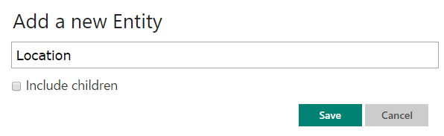
How LUIS works
Add intents and
entities
2
Entities:
Entities are real world objects such as persons, locations, organizations, products, etc. that can be denoted with a proper name. Entities can be abstract or have a physical existence.
Entities can be generic (location, celebrity, datetime) or more specific (Seattle, Satya Nadella, June)
Add one or more entities that you expect your app to recognize by clicking + next to Entities item in the left-hand panel of the Editor Workspace.
Several commonly used pre-built entities (e.g. datetime, number) are also available to be added to the app by clicking + next to Pre-built Entities.
X

Slide 15
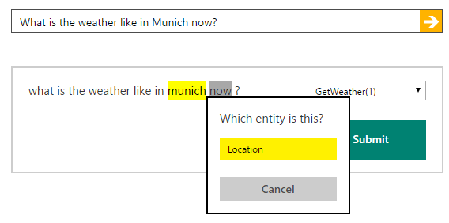
How LUIS works
Provide more
labeled examples
3
Seed the system with more examples of utterances:
Enter more examples of queries that you expect your users to make.
As you enter each one, you will need to:
select the name of the correct intent from the dropdown
label your entities that appear in each utterance by clicking on the entity and choosing corresponding label from the list
pre-built entities get automatically labeled in grey
The more examples you provide, the more accurate the predictions.
X

Slide 16
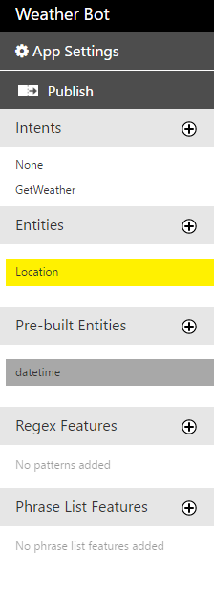
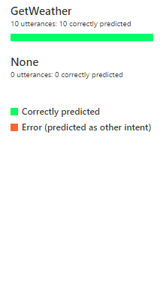
How LUIS works
Train your model
4
As you click Train at left bottom corner of the page, LUIS:
Generalizes from the examples you provided.
Uses logistic regression classifiers to recognize intents.
Uses conditional random field to determine the entities.
Last train completed: 9/10/2016, 3:33:38 PM

Slide 17
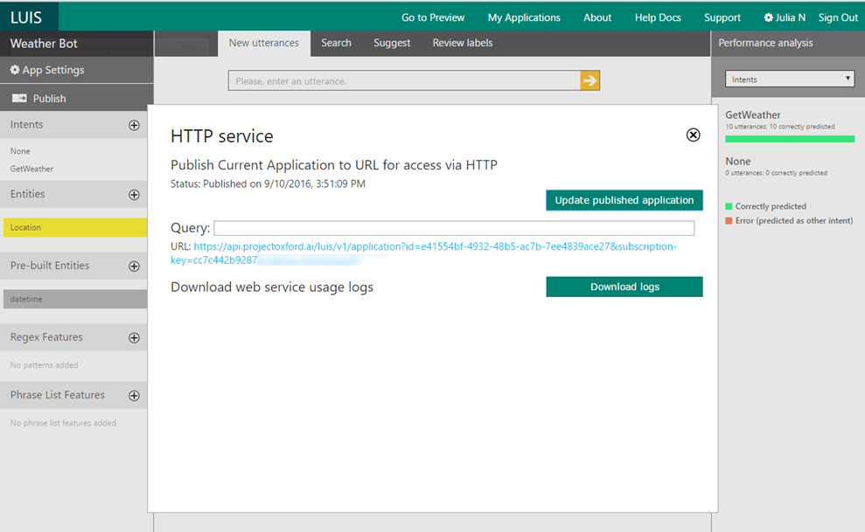
How LUIS works
Publish your model
5
Deploy the model to an HTTP endpoint:
Click the Publish button in the upper left-hand corner.
The URL that you see appear after a few moments makes your model available as a web service.

Slide 18
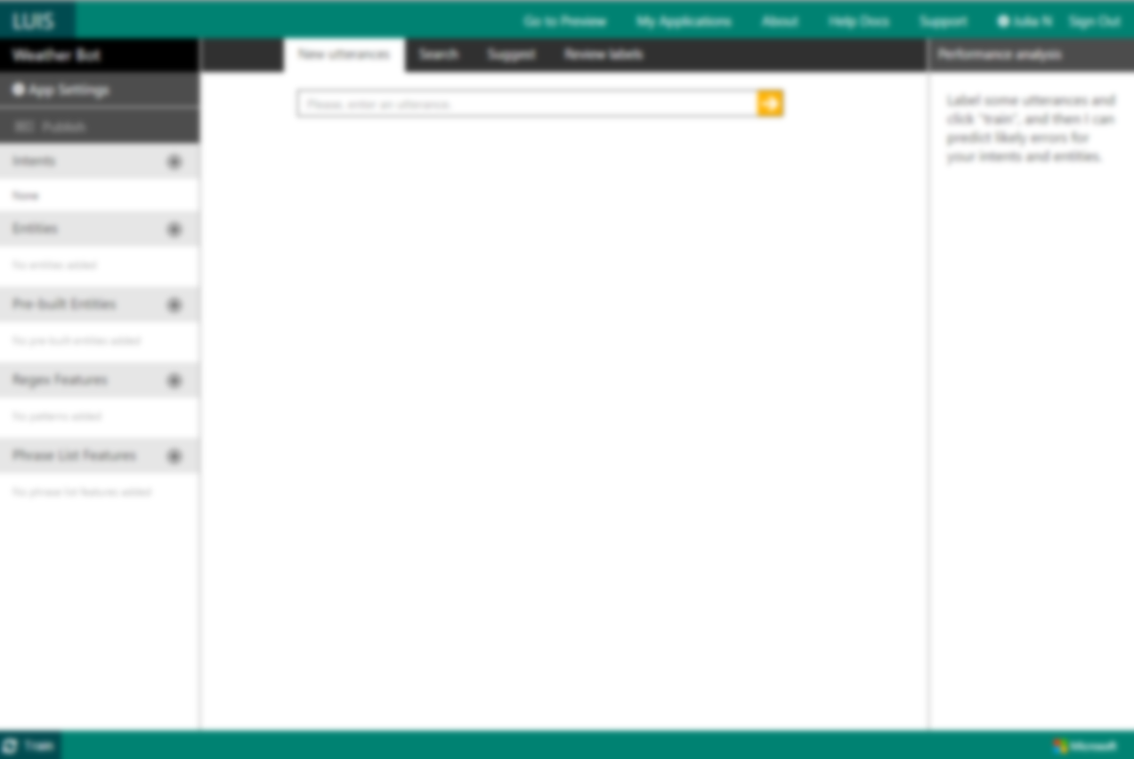
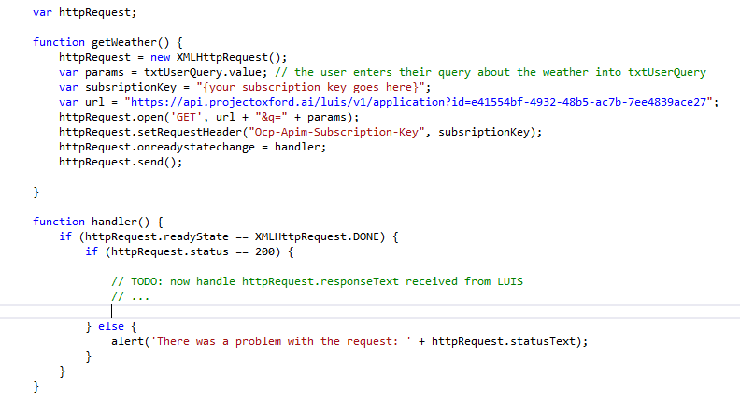
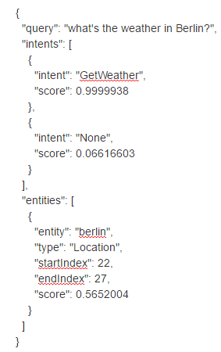
How LUIS works
Use the model in
your application
6
X
Activate model from your application on any device:
Update the URL with the parameter for the user query.
The response received from LUIS will contain the list of detected intents and entities together with the confidence scores.
You can now use this information in your app. For our example, we could next call the weather service and display the response in our app UI:
What’s the weather in Berlin
The weather is sunny with a temperature of 88°F. (data provided by Foreca http://www.foreca.com)

Slide 19

Advanced features

Slide 20
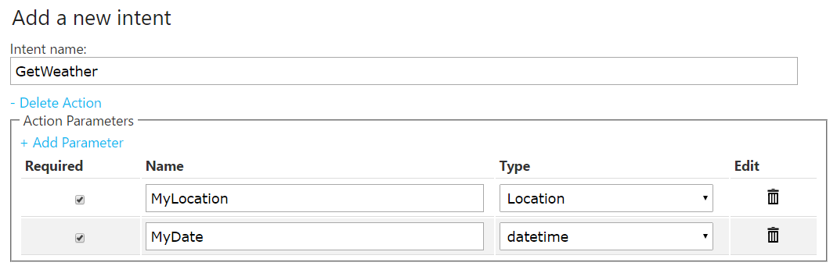
How LUIS works
Action binding
Define actions:
You may (optionally) link your intents to actions and specify requirements for the action to be triggered.
LUIS supports only one action per intent. Each action can include a group of parameters derived from entities.
Add actions, but by clicking + Add Action in the ‘Add a new intent’ dialog. entering action parameters and specifying which if any of these are required.
X

Slide 21
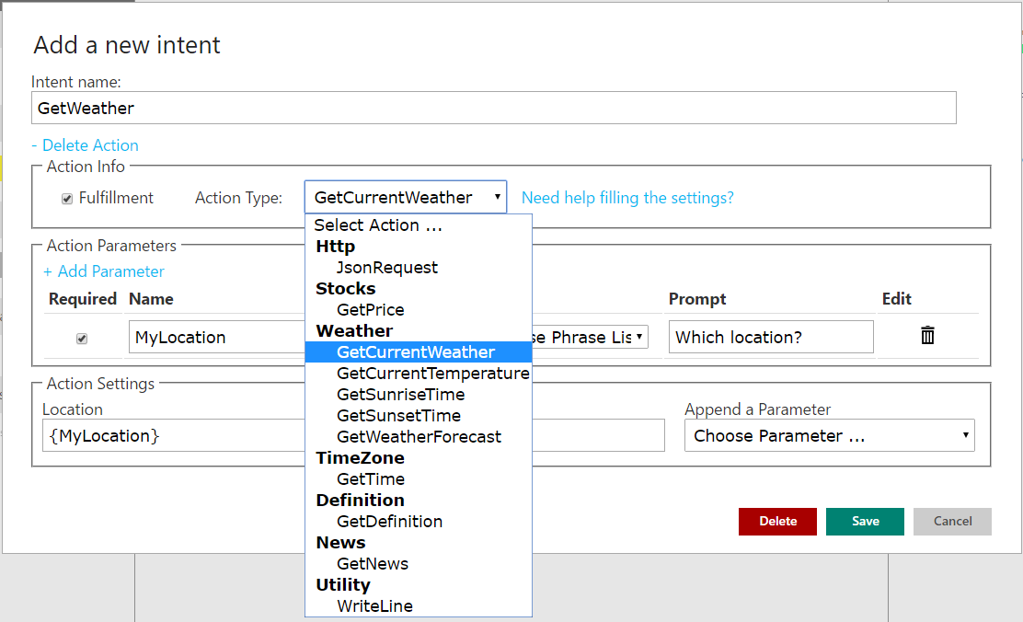
How LUIS works
Action fulfillment
Actions:
Once actions are defined, LUIS enables to fulfill those that were trigged through a set of channels. For example, if you created the "GetWeather" intent and the action has been triggered (all the required parameters were filled), you can use the GetCurrentWeather channel to retrieve the weather for your users to see.
To use this feature, select Go to Preview in the LUIS Application Editor top ribbon. Then, select the intent that is linked to the action you want to fulfill and fill out Action Info sub-section to enable action types.
In the Action Settings sub-section, map the action to a parameter from the Append a Parameter drop-down list, in this case “location”.
X

Slide 22
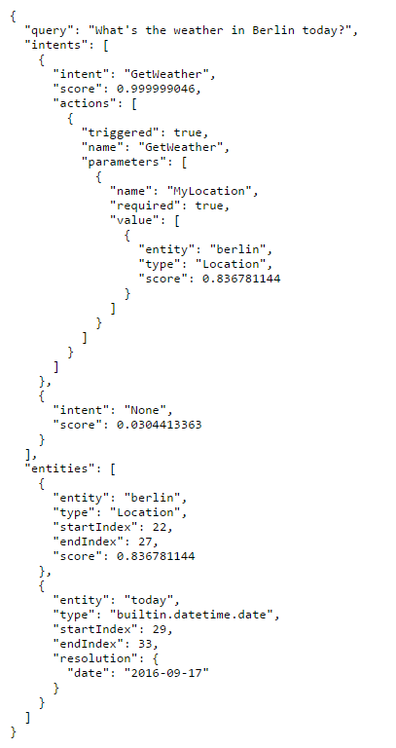
How LUIS works
Action fulfillment
JSON Response:
Here is an example of the JSON response that is returned when an action is fulfilled.
Notice that the “MyLocation" required parameter is set to TRUE, which means this parameter was filled in. Thus, the action will be triggered as all of its required parameters are available.

Slide 23
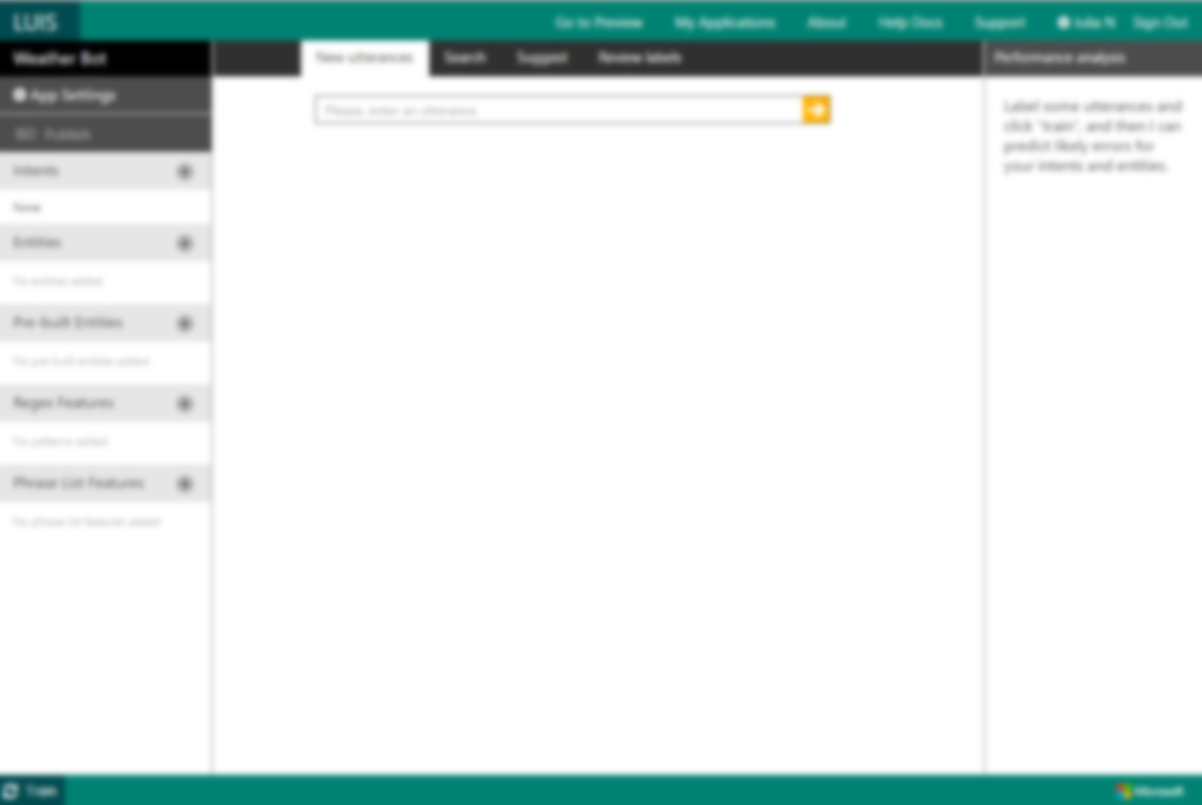
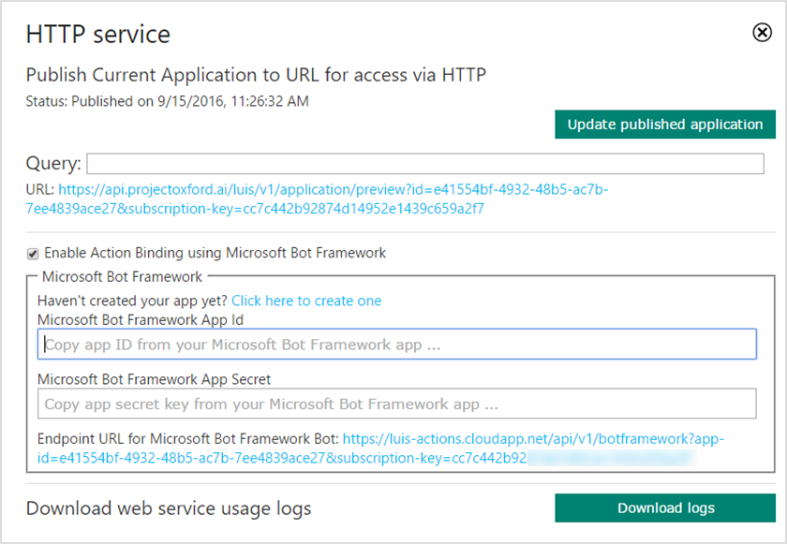
Bot Framework Integration
Use LUIS to create and connect
intelligent bots with users
Create a new bot in the MS Bot Framework:
After you Publish your model via LUIS Application Editor Workspace and get the dialog box that contains the URL, select “Enable Action binding using Microsoft Bot Framework”.
The link in the field brings you to the webpage where you can create your bot. You can register a new bot right there.

Slide 24
Bot Framework Integration
Use LUIS to create and connect
intelligent bots with users
Configure LUIS to enable calling one service to the other:
Once the new bot is created, copy the App ID from the Microsoft Bot Framework to your LUIS application.
Copy the App secret into the correct field in the LUIS publish dialog box as well.
Finally, copy over the redirect URL provided by LUIS to your app on Microsoft Bot Framework. Note: same URL as in the registration step.
When this configuration is done and the application is correctly created within the Bot Framework, there are additional steps required to enable various channels depending on your preferences. Follow the instructions on Microsoft Bot Framework, to enable SMS, Slack, etc.

Slide 25
LUIS Improve model performance
Add model features
Add more labeled utterances
Fix incorrect utterance labels
Change the schema
Providing explicit knowledge about the entities by creating a list that features them helps LUIS with sentence analysis. Add features with some or all of an entity's values via Phrase List Features
Ultimately, performance of ML models depends on quality and quantity of the labels. The more labels, the greater the performance
A common cause of error can be traced to a label that has been mis-assigned
In some cases, the schema and the definitions of the intents and entities are too hard for a ML algorithm to learn
Why it helps
The model fails to see that a class of words or phrases is similar (e.g. names of cities).or is having trouble identifying an entity
The model fails to act on rare or proprietary words
The model fails differentiate between two different intents
The model fails to recognize an entity based on words that surround it
The model erroneously and systematically assigns low scores to one intent
The model fails to differentiate between two different intents, even though similar utterances have been labeled
An entity is consistently being missed, even though similar utterances have been labeled
You have difficulty deciding how to label utterances, and the model is performing poorly, despite having tried all the other options described here
Changing the schema might mean combining, re-grouping, or dropping intents or entities
When to use

Slide 26
LUIS Pricing
Free Plan
Standard Plan
Free for up to 10K transactions per month
$0.75 per 1K transactions* as you scale up
Limited to 5 TPS
No monthly quota limits
Limited to 10 TPS
Once the monthly quota is reached, the API will start returning an error code.
If the quota is reached or if higher throughput rate is desired, the customer needs to upgrade from the free tier to the paid plan
*Current rate is discounted until GA
For unlimited traffic to your HTTP endpoint, you must create a metered key for your account by signing into Microsoft Azure Portal and following the steps outlined here.
Notes:
We allow up to 10k calls per month for free – that’s a lot!

Slide 27
LUIS Top FAQs
What languages does LUIS support?
Can LUIS be accessed programmatically?
How do I get subscription keys for LUIS?
Does LUIS allow app sharing?
The LUIS UI is always in English, but several languages such as English, French, Italian, Spanish, Chinese, German, Japanese and Portuguese are supported when it comes to understanding utterances.
LUIS offers a programmatic REST API that can be used to automate the application creation process. This API allows you to author and publish your application by using LUIS endpoints.
Visit https://www.microsoft.com/cognitive-services/en-us/luis-api/documentation/azureibizasubscription
for detailed information about the subscription process.
LUIS provides a way to export all of the labels and features entered for an application to a JSON file that can be shared with other LUIS developers or re-imported into a different application.

Slide 28

Next steps
To learn more about LUIS and Microsoft Cognitive Services:
www.microsoft.com/cognitive
To try and evaluate LUIS for free, please visit:
www.luis.ai

Slide 29
Support Forum? stackoverflow tag: microsoft-cognitive
UserVoice: https://cognitive.uservoice.com/

